Slide 1

Searching Algorithms
Design & Analysis

Slide 2
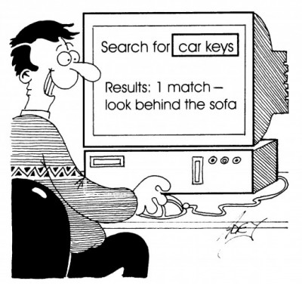
Analysis of:
Searching Algorithms
Linear Search
Binary Search
Interpolation Search

Slide 3

Search Problem
Is the value K present in a collection A?
Does the structure matter?
Array Vs List
Does the organization of the information matter?
Values are sorted/unsorted

Slide 4
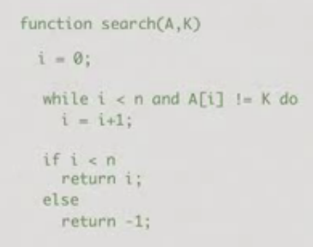
Linear Search(Unsorted Case)
Worst case
Need to scan the entire sequence A
O(n) for input sequence of A- takes linear time.
Does not matter whether A is list or an array

Slide 5
Best case, Worst case, Average Case Analysis
Best case time complexity
If an algorithm takes minimum amount of time to run to completion for a specific set of input
Linear searching - C_{best}=1
Worst Case complexity
If an algorithm takes maximum amount of time to run to completion for a specific set of input.
Linear searching - C_{worst}=n
Average case
Gives information about the behaviour of an algorithm on specific or random output
Linear searching - C_{avg}=(n+1)/2

Slide 6
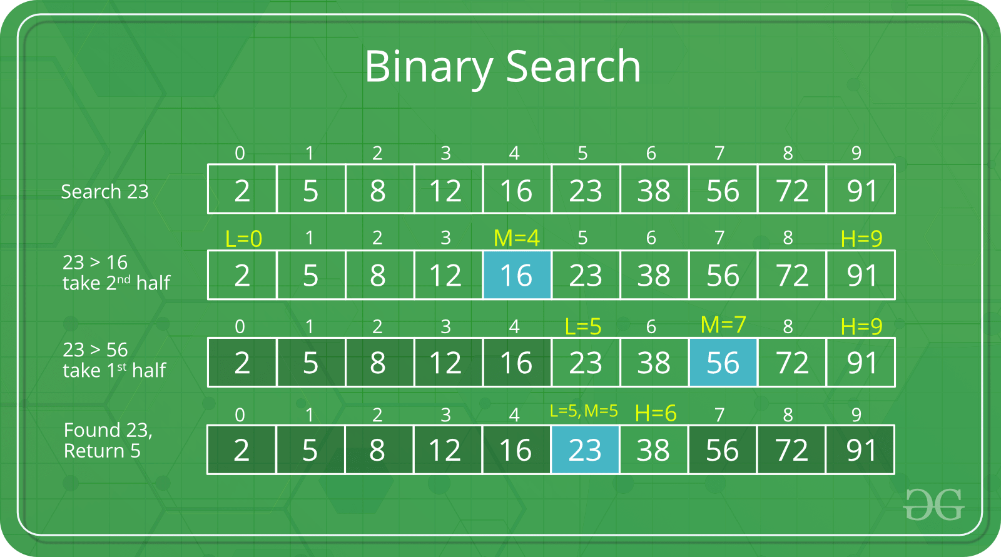
Binary Search
What if A is sorted?
Compare K with mid-point of A.
If mid-point of A is K, Value is found.
If K less than mid-point, search left half of A.
If K greater than mid-point, search right half of A.

Slide 7
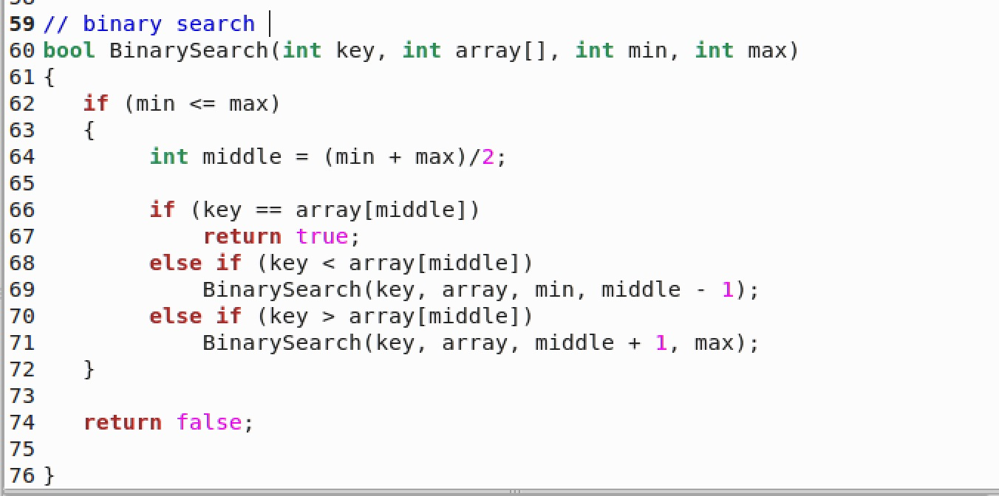

Slide 8
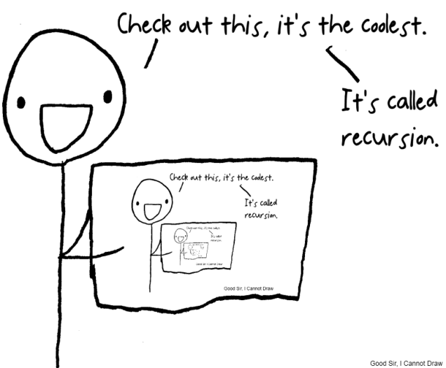
How long does this take?
Each step halves the interval to search
For an interval of size 1, the answer is immediate.
T(n):time to search in a list of size n
Recurrence function
T(1)=1
T(n)=1+T(n/2)
Unwinding....
T(n) =1+T(n/2)
=1+1+T(n/4)=1+1+T(n/2²)
=1+1+1+T(n/2³)
=1+1+...k+T(n/2^{k})
=O(log(n))

Slide 9
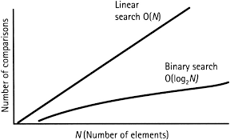
Worst Vs Best Case in Binary Search

Slide 10
Interpolation Search: Beating Binary Search
Alternative to binary search that utilizes information about the underlying distribution of data to be searched.
Binary search always splits the array in half and inspects the middle element.
Interpolation search narrows the search space and tries to predict where the key would lie in the search space via a linear interpolation, reducing the search space to the part before or after the estimated position if the key is not found there.
Resembles how humans search for any key in an ordered set like a word in dictionary.

Slide 11
Interpolation Search:
Searching is guided by the values of the array
Lo: lower Index
Hi: Higher Index
search position
if x[h] = key element found; else search array on the left or on the right of h
e.g.
search(80): focuses on the 20% rightmost part of the array
h = Lo+((Hi-Lo) / (A[Hi]-A[Lo])) * x-A[lo]
0 |  |  |  |  |  |  | 100
Binary search always goes to the middle position

Slide 12
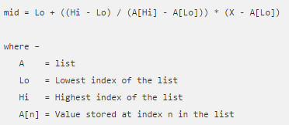
Example
Position Probing in Interpolation Search
Interpolation search finds a particular item by computing the probe position.
If a match occurs, then the index of the item is returned. To split the list into two parts, we use the following method −

Slide 13
Algorithm-Interpolation Search
Step1: In a loop, calculate the value of “pos” using the probe position formula.
Step2: If it is a match, return the index of the item, and exit.
Step3: If the item is less than arr[pos], calculate the probe position of the left sub-array. Otherwise calculate the same in the right sub-array.
Step4: Repeat until a match is found or the sub-array reduces to zero.

Slide 14
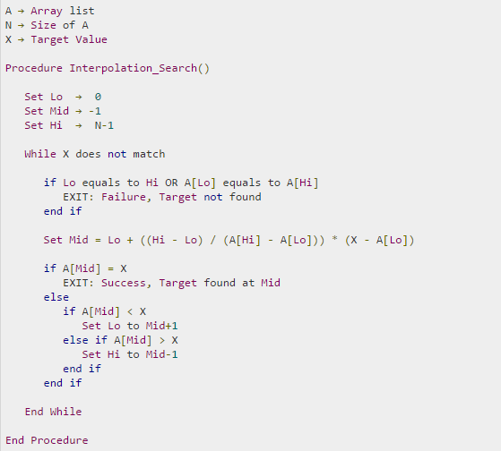
Pseudo Code

Slide 15
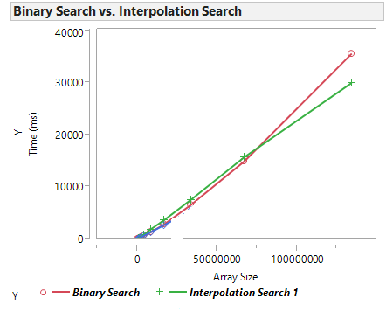
Complexity
Average case: O(log(log n)) uniform distribution of keys in the array.
Worst case: O(N) on non uniform distribution
Binary search is O(log n) always!

Slide 16


